Slide 1
Workforce & Project Performance Insights
Identifying The Key Areas of Concern

Slide 2
The goal of this project
Identify At-Risk Departments and Projects: Determine which departments and projects are over budget or underperforming to enable corrective actions.

Slide 3
Dataset Structure
The dataset consisted of seven Excel tables,
including information about
Employees, Projects and Departments

Slide 4
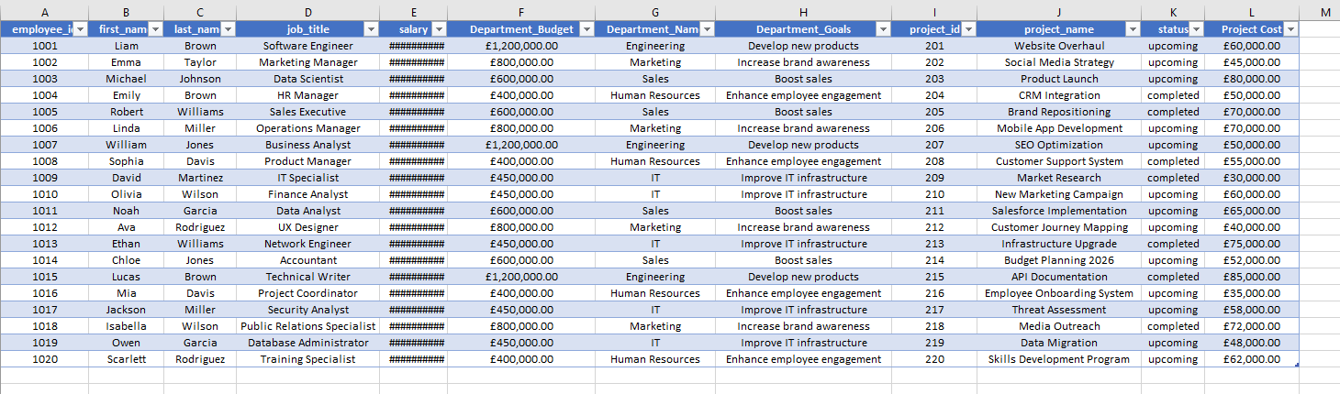
Cleaning and combining data from seven Excel tables into one table.

Slide 5
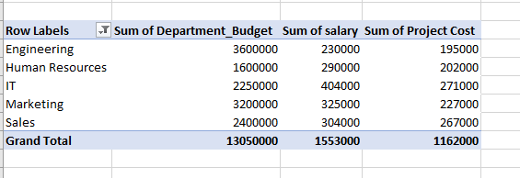
Pivot table displaying the 4-year budget, annual salary, and annual project costs grouped by department

Slide 6
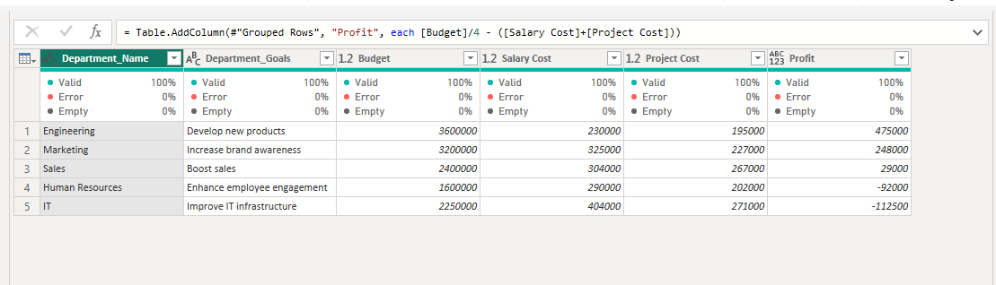
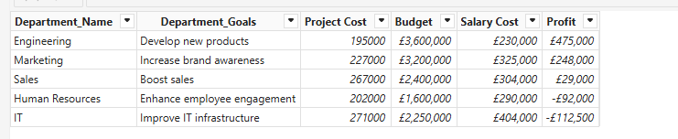
Analysing data in Power BI and calculating the profit column

Slide 7
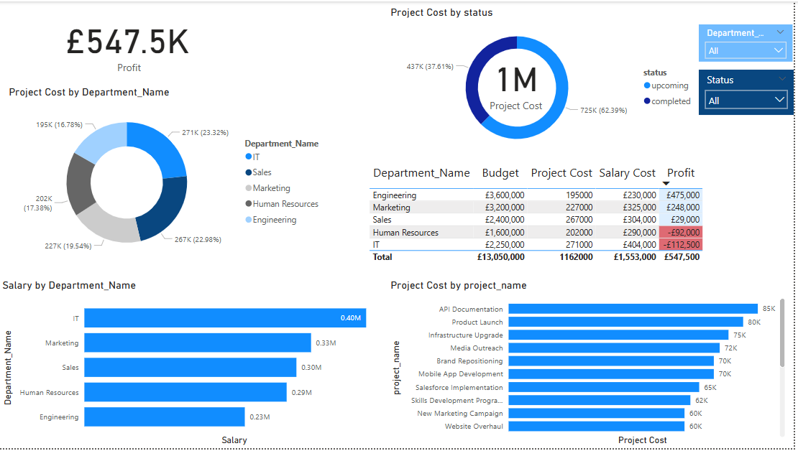
Dashboard

Slide 8
Insights and Recommendations
The two departments not making a profit are:
Human Resources: Profit of -£92,000
IT: Profit of -£112,500
Actionable Insights:
Conduct a detailed analysis of the HR and IT team's structure, roles, and responsibilities.
Identify any potential redundancies or areas where tasks could be streamlined or automated to optimise salary costs.
Break down the Project Cost into specific projects. Evaluate the ROI and necessity of each project. Are there any projects that can be delayed, scaled back, or eliminated to reduce costs?

